Slide 1

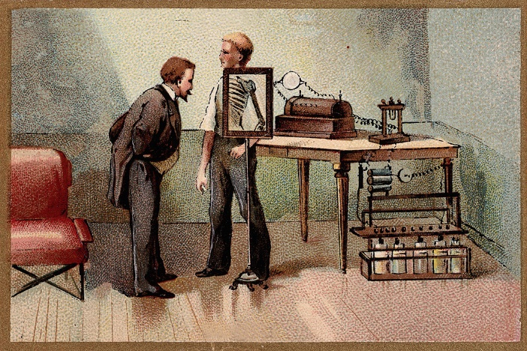
LITERATURE SCAN
OVERVIEW

Slide 2

AREAS OF IMPACT
Family life
Interaction between learners
Interaction between teachers and learners
Interaction between teachers and parents
Equity/equal opportunities/inclusion issues
Community involvement in teaching and learning
Online, or ICT based teaching
Development of teacher trainees
Professional development of teachers
Mentoring coaching and counselling
Co-operation collaboration of teachers/educators
Interprofessional learning of teachers
Research
Innovation
Leadership
  Family life
  Interaction between learners
  Interaction between teachers and learners
  Interaction between teachers and parents
  Equity/equal opportunities/inclusion issues
  Community involvement in teaching and learning
  Online, or ICT based teaching
  Development of teacher trainees
  Professional development of teachers
  Mentoring coaching and counselling
  Co-operation collaboration of teachers/educators
  Interprofessional learning of teachers
  Research
  Innovation
  Leadership
  Family life
  Interaction between learners
  Interaction between teachers and learners
  Interaction between teachers and parents
  Equity/equal opportunities/inclusion issues
  Community involvement in teaching and learning
  Online, or ICT based teaching
  Development of teacher trainees
  Professional development of teachers
  Mentoring coaching and counselling
  Co-operation collaboration of teachers/educators
  Interprofessional learning of teachers
  Research
  Innovation
  Leadership

Slide 3

Three waves
A technology wave, searching for the right tools and platforms to guarantee continuity of education
  Access to computers, laptops, tablets, mobiles
  Infrastructure, Networks, Wifi, Capacity
  Platforms (Zoom, Webex, Teams, Mahara, Moodle,….)
  Technological expertise and support

Slide 4

2. Methods and Didactics
Methods and methodology/didactical wave, to optimize the quality of the online offer
  How to manage the selected platforms
  How to engage the students
  How to monitor progress
  How to keep track of needs of the students

Slide 5
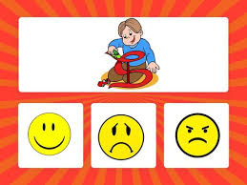
3. Social emotional wave
A social emotional wave, to cope with the social emotional well-being impact of online, or blended education
  How to prevent isolation and loneliness
  How establish a sense of respect in web communication (behaviour)
  How to prevent stress and health problems related to computer work

Slide 6

Extending learning environment
Impact on learners
Impact on teachers on teachers
Impact on the wider learning, and educating community

Slide 7
Priorities
Giving support to teachers in preparing and providing online, or otherwise ICT based, or blended quality teaching and learning in schools.
Providing teachers with tools and strategies to support them in processes of mutual coaching and professional learning and development
Offering resources to help schools engage all partners involved in the educative process, including home learning, and or other relevant educative settings

Slide 8

Examples of implications for teachers
Pay attention to technological, didactical and social emotional aspects at the same time
Develop and store course ware and work on its optimization, build a repository of resources and tools
Care for the vulnerable pupils/students
Be aware of the need for web etiquette

Slide 9
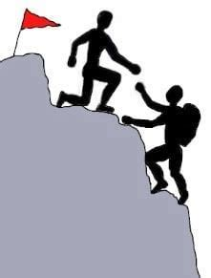
Examples of implications for professional development
Analyze teachers’ tasks
Divide and allocate tasks
Work together
Learn together
Facilitate each others learning
Build knowledge together

Slide 10

Examples of implications for the involvement of other educators
Seek to involve parents
Connect to other educative services (broadcasting companies, sports clubs, social work, educative courseware developers)
Consider ways to support/direct these partners to guarantee educative quality

Slide 11

Policy priorities
Focus on ICT equipment
Focus on infrastructure
Legal and insurance (conditions)
Re-validate rules on absenteeism
Raise Funding from other sources than the authorities
Invest in teachers’ competences development
Be aware of issues of privacy, copyright
Involvement of other actors (broadcasting companies, industry, churches, software developers)
Issues on monitoring and assessment (fairness and fraud)

Slide 12

Food for thought
It appeared hard to reach the vulnerable
Little attention was paid to mental well-being
Countries differ in the extent to which they seek to solve things centrally, or de-centrally, find a balance
Different positions and roles arose in schools (ICT, communication, courseware development, online counseling, etc.)
Be aware that crises may return, or new ones may pop up, so try to upgrade the level of preparation for such crises
To little is done to make schools and teachers and other educators learn together and from each other.
Strengthen the sector by involving a wider variety of competences and expertise.

Slide 13

What is needed?
Rapid(e) Solutions

